Slide 1
Workshop 5

Slide 2
Objectives
In this workshop, students will revise on
How to implement color and object detection together
python coding via quiz

Slide 3
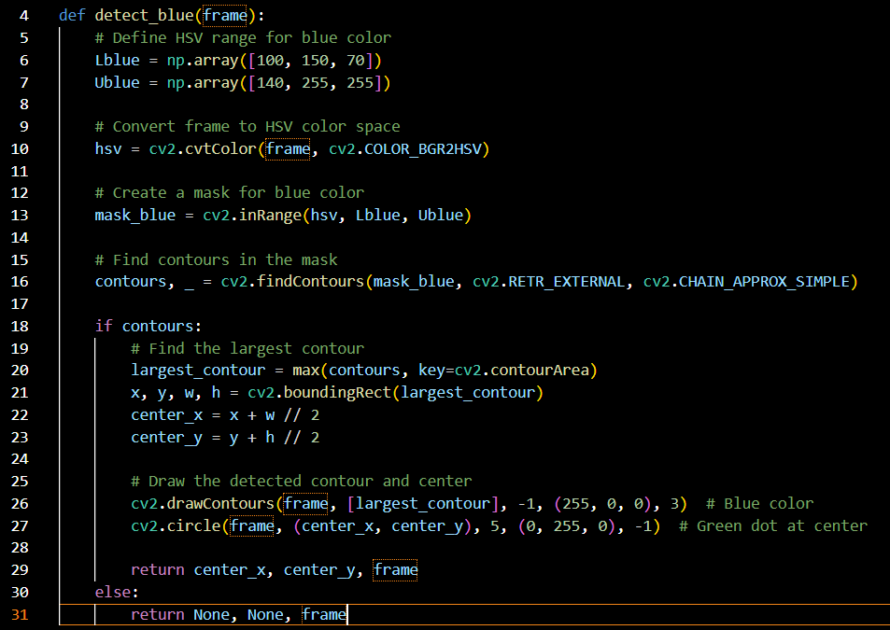
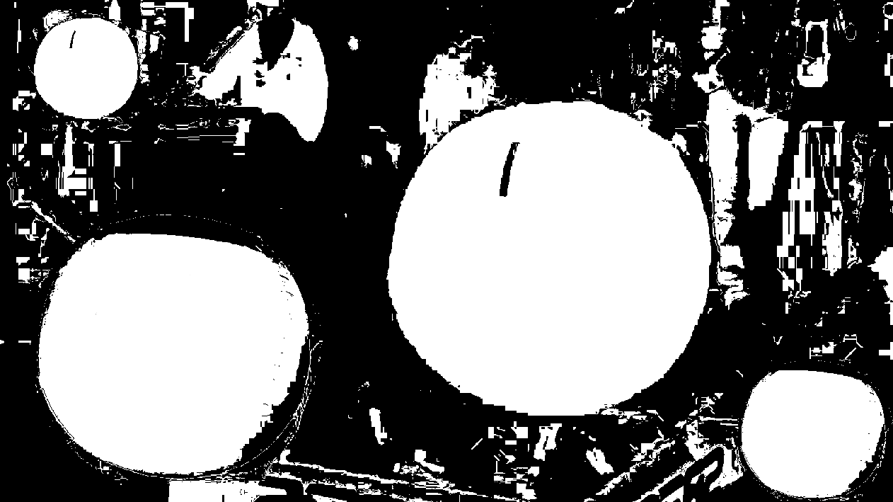
Recap: Color and Contour detection
You have learnt how to code color detection using opencv to do these:
Apply a mask using a range of HSV value on a image from the drone’s camera. An example of masked image:
Find all contours from the mask.
Get the largest contour.

Slide 4
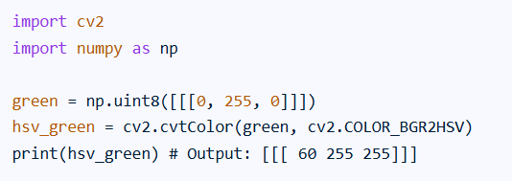
Steps to find HSV range using opencv
Step 1: Using cv2.cvtColor(): You can convert BGR values to HSV to find the corresponding HSV value. For instance, to find the HSV of green:

Slide 5
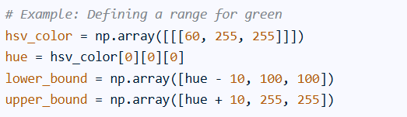
Steps to find HSV range using opencv
Step 2: Defining the Range.
Once you have a base HSV value, define a range around it to account for variations in lighting and color. A common approach is to add and subtract a tolerance value from the Hue, while also considering ranges for Saturation and Value.

Slide 6



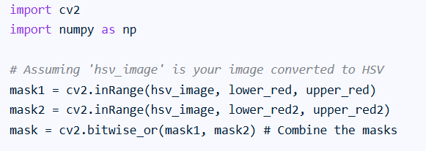
How to handle red color as it has more than one spectrum
Red color has two ranges:
Lower red:
Upper red:
Other red:
Create mask for red:

Slide 7
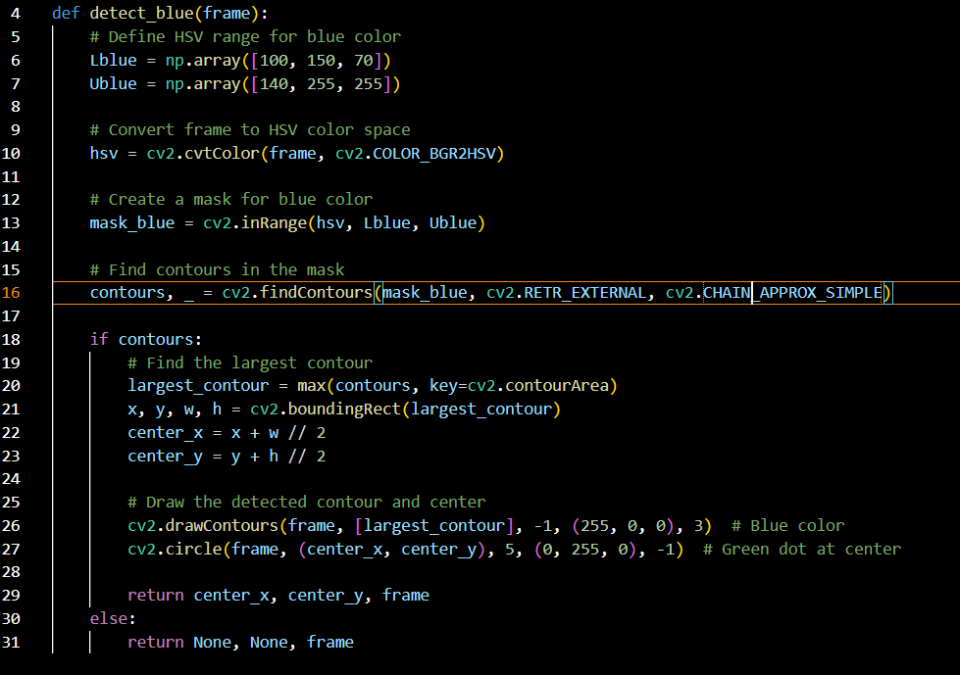
cv2.findContours
There are three arguments in cv.findContours() function:
first one is source image
second is contour retrieval mode,
third is contour approximation method.
And it outputs the contours and hierarchy and modified image ( _ ). contours is a Python list of all the contours in the image. Each individual contour is a Numpy array of (x,y) coordinates of boundary points of the object.
Why cv2.RETR_EXTERNAL?
If you use this flag, it returns only extreme outer flags.
Read https://docs.opencv.org/3.4/d9/d8b/tutorial_py_contours_hierarchy.html to find out more
Why cv2.CHAIN_APPROX_SIMPLE?
If you pass cv.CHAIN_APPROX_NONE, all the boundary points are stored.
Do you need all the points? No, we need just two end points of that line. This is what cv.CHAIN_APPROX_SIMPLE does. It removes all redundant points and compresses the contour, thereby saving memory.

Slide 8
How to implement to detect both color?
Simplest way: One function for detecting one color. In the detection loop, call the functions one by one over the same image.
There are ways such as one function for all colors.

Slide 9

Detecting Logos
Use tflite_detector library.
Where to find tf_detector library? -> NYTC_2025 Google Classroom->Classwork->Machine Learning and Coding->hula video library and tflite_detector library
What is it?
It is library to use object detection model generated by Google Vertex AI to detect logos.
Where to find the model?
NYTC_2025 Google Classroom->Classwork->Machine Learning and Coding->Model to detect IMDA Logo and Google Logo

Slide 10
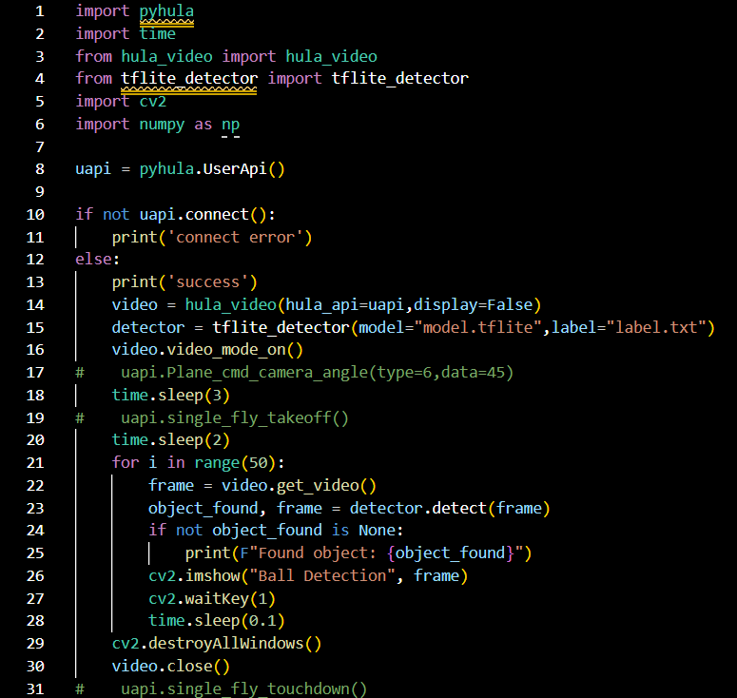
How to use tflite_detector library?
IMPORTANT: Put tflite_detector.py file and model file and label file in the folder that contains your code.
Make the first few lines of your code has import tflite_detector
Steps on how to use in your code:
Line 15 - initialize tflite_detector
Line 23 - call detect method to detect which returns a dict containing the detected object with the highest confidence.

Slide 11
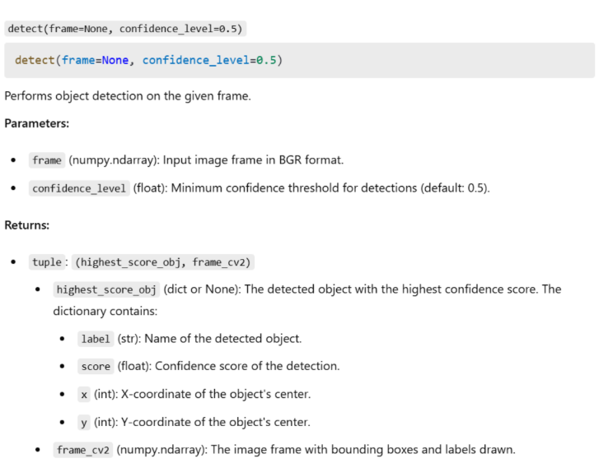
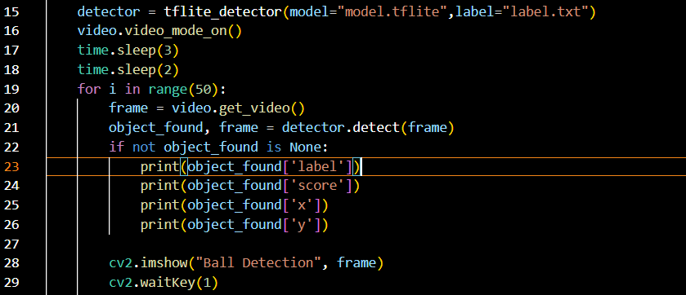
What does detect() method returns?
An example on how to use the return dict:
Line 22 - check if the logo are detected
Line 23 - print out the name of the detected logo
Line 24 - print confidence score
Line 25 - print x coordinate of the detected object center
Line 26 - print y coordinate of the detected object center

Slide 12
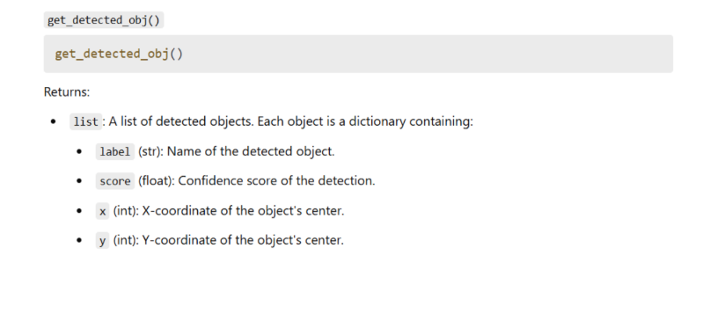
How about the other method in tflite_detector? The method returns all detected object.

Slide 13
How to implement to detect both color and logo together
Simplest way: One function for detecting one color.
In the detection loop, call the color detection functions one by one, follow by detection of logo using tflite_detector over the same image.
And then process the results which is checking if it is None object return.
If it is not None, there is result.
If it is color check and not None, it will be x , y value only followed by modified frame. The modified frame is image that has bounding box marked over the detected color and contour.
If it is logo detection and not None, it will be a dict followed by modified frame.The modified frame is image that has bounding box marked over the detected color and contour.

Slide 14
Breakout Room: Quiz Time
Attempt all questions in Quiz 5 in your breakout room. (IMPORTANT)
Ask your instructors if not sure.

